Slide 1

Exploring the Differences in Mental Rotation of Letters and Faces
Comparing Reaction time
Group 5:
Guo Ran
Dang Qianqian
Shao Mingxin
Notes:
Good evening,everyone, `Today we will talking about Exploring the Differences in Mental Rotation of Letters and Faces Comparing Reaction time. We are group 5, group members are Guo Ran
Dang Qianqian and Shao Mingxin.

Slide 2






Outline
Discussion
Hypothesis
Background
Results
Conclusions
Design
Notes:
Our presentation was divided into six parts, with background and assumptions being my part, design and results by Guo Ran, and discussion and conclusion part by Qian Qian.

Slide 3
Motivation for the study
Mental rotation tasks are a key tool used in cognitive psychology to assess an individual's spatial visual processing ability. Through this type of task, it is possible to observe and assess how individuals mentally manipulate and transform visual information.
The human face is a unique and complex visual stimulus involving specialised cognitive and neural mechanisms.
With the development of image recognition and machine learning techniques in the field of artificial intelligence, there is an increasing need for accurate processing and understanding of face images presented from multiple perspectives.
Notes:
I will talking about backgroud part. Fristly Motivation for the study.

Slide 4
Overview Question
Explore cognitive differences in participants' processing of the letter R and face images in a mental rotation task.
Explore differences in participants' reaction times when processing letter R and face images.
Explore changes in the rotation angle of the images (increasing every 60°) to assess the possible effects of rotation angle on cognitive processing.

Slide 5
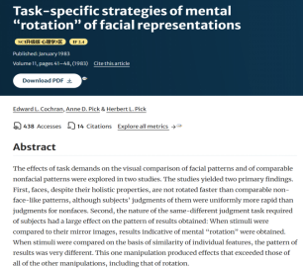
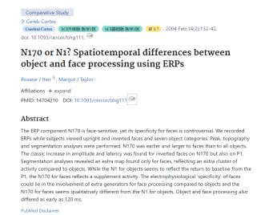
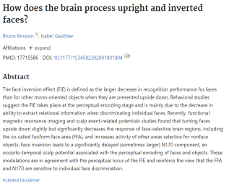
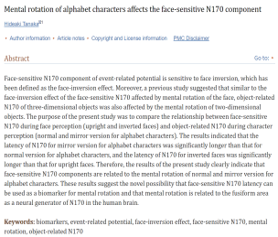
Current research:
It highlights how face direction affects recognition speed, showing that rotation increases the time required for recognition. However, changes in face emotion do not significantly affect recognition time. But our study compares the recognition response rate of faces and letters.
This article two studies examined the effects of task demands on visual comparisons of face patterns and comparable non-face patterns. Subjects were consistently quicker to judge faces than non-faces. But our study felt that faces RT to be slower.
Face recognition relies on the brain's specialised overall processing mechanisms and is particularly sensitive to face rotation, leading to a significant reduction in recognition efficiency when inverting or rotating the face.
In contrast, other classes of visual objects recognition, which is processed mainly through partial information processing, is less sensitive to rotation, and therefore rotation has less of an effect on other classes of visual objects recognition. However, its rotation angle and experimental materials are different from our study.
Faces trigger unique neural responses, as shown by ERP components such as N170 and P1, which behave differently when processing faces compared to other objects. No analysis of behavioural data, different from ours

Slide 6
In different sets of independent variables - material type (letter/face) and rotation angle (every 60° increment) - there will be significant differences in reaction time (RT).
Effect of material type on RT: It is expected that the RT for the face rotation task may be higher than that for the letter rotation task.
Effect of angle and material type on RT: We expect RT to increase with rotation angle for both letters and faces. However, faces will be more sensitive to the rotation angle. An increase in face rotation angle may result in a significant change in RT.

Slide 7




Train
Letter 60trials
Male Face
60trials
Female Face
60trials
Letter
60trials
1040*800
5 seconds
Angle difference
6 levels
Showed randomly
Each 10times
Next trials
By click button
To judge whether is same letter or not
30seconds break
Next part

Slide 8
Stimulus Material
overturn
Letter
In total, there are 144 kinds of stimulus
Congruent and incongruent have same amount
Every level of angle difference has 24 kinds of stimulus
Rotate
60°
120°
180°
240°
300°
Paired and labeled
By angle difference

Slide 9


Stimulus Material of Face
Start
Generate Latent Space
Sampling from it
Distance-based Image
The process begins with pretraining the GAN on the CelebA-HQ dataset, focusing on 30,000 high-resolution images of celebrity faces.
Develop a 512-dimensional latent space that captures the key features and variations from the CelebA-HQ dataset.
Randomly sample points from the latent space using a multivariate normal distribution to generate initial source images.
From each source image, generate new images by adjusting specific distances in latent space, creating series of images that progressively differ from the original.
Prepare Experiment Setup
Apply Mask
Manual Inspection and Selection
Two of the 18 were selected with asymmetric features
Apply a gray, ellipsoid mask to each image to reduce visual variance not related to facial features.
Manually inspect the generated images, remove any with visual artifacts, and randomly select 18 images as source faces for the experiment.

Slide 10
Variables list
Within-subject Variables A: Stimulus type, 2 levels, Face & Letter
Within-subject Variables B: Angle difference, 6 levels, 0°,60°,120,°180°,240°,300°
Between subject Variable C: Participant gender, 2 levels, Male & Female
Depended Variables: the Reaction time of judge paired stimulus is same or not
Inclusion criteria: remove incorrect trials; remove reaction time more than 6000ms
Methods: average the reaction time of same type trials with same angle, and apply mixed ANOVA analyze

Slide 11
Source | DF | SS | MS | F value | P value | Partial η²
Between-subjects | 1 | 484880
Gender | 1 | 484880 | 484880 | 3.226 | 0.074 | 0.048
Within-subjects | 6 | 31814394
Type | 1 | 1209394 | 1209394 | 8.046 | 0.005 | 0.437
Angle | 5 | 30605000 | 6120995 | 40.721 | <0.001 | 0.759
Interaction | 16 | 10639419
Type * Angle | 5 | 9512261 | 1902452 | 12.656 | <0.001 | 0.721
Type * Gender | 1 | 301133 | 301133 | 2.003 | 0.158
Angle * Gender | 5 | 618910 | 123782 | 0.823 | 0.534 | 0.008
Type * Angle * Gender | 5 | 207115 | 41423 | 0.276 | 0.926 | 0.078
Error | 187 | 30664600
Total | 227 | 76765300

Slide 12
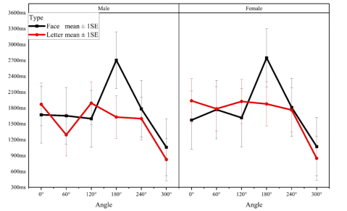
***
***
*
**
**
**
***
***
***

Slide 13
Conclusions:
Significant effects of rotation angle on reaction time, indicating increased task difficulty with larger angles.
Face recognition tasks demonstrated longer reaction times than letter recognition, likely due to more complex cognitive processing involved.
Differential sensitivity to rotation angle between face and letter stimuli, with a notable increase in sensitivity for face recognition as the angle increased.

Slide 14

For angle:
Our study largely corroborates the conclusions of previous research: an increase in angle leads to an increase in reaction time, and the angle is a key factor affecting performance in mental rotation tasks. The impact of rotation angle is likely related to the intrinsic nature of the recognition task (recognizing rotated objects requires mental transformation). (Cooper and Shepard, 1973; Shepard & Metzler, 1971)
The cognitive processing workload required at each angle varies; the cognitive system may employ different strategies when handling rotational information.

Slide 15


For type:
The difference in reaction times between rotating faces and letters indicates that different types of stimuli require different cognitive resources. As expected, rotating faces takes longer than letters, likely due to the more complex cognitive mechanisms involved in face recognition.
Face recognition is a highly complex process. Although our mental rotation tasks do not involve the specific processing of facial recognition, letters are shapes with which we are more familiar and more regular. Faces, on the other hand, contain many more elements (Bruce & Young, 1986), thus necessitating longer mental processing times.
Additionally, we believe that the neural circuits and brain areas involved in the mental rotation of faces and letters are distinct. The core processing mechanisms for faces are primarily located in the occipital and temporal lobes. Imaging studies of mental rotation tasks consistently show activation in the posterior parietal cortex (extending downward to the superior occipital areas) (Zacks, 2008). A 2020 study noted that the rotation of faces elicited a stronger N170 component (Tanaka, 2020), which is closely associated with the initial processing of faces by the visual system.
In another study comparing the mental rotation of faces versus letters, no significant behavioral differences were found, which is inconsistent with our results (Tanaka, 2020).
Notes:
Differences in reaction times between rotating faces and letters highlight varying cognitive demands for different stimuli. Face rotations require more time, underscoring the complexity of facial recognition mechanisms.
Face recognition, involving numerous elements, demands extensive mental processing, especially compared to the more familiar and simpler shapes of letters . The neural pathways for rotating faces and letters differ; face processing primarily activates the occipital and temporal lobes. Conversely, mental rotation tasks light up the posterior parietal cortex . Face rotations also intensify the N170 component, linked to initial face processing . Tanaka's research found no difference in behavior when comparing rotating faces to letters, which does not match our results and implies that the reasons might be complex.

Slide 16
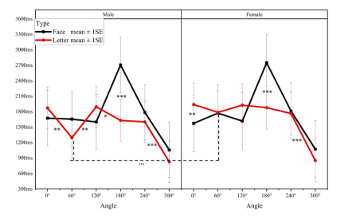
WHY?
Why is there a significant drop in reaction time at the 300-degree level?
Notes:
Now, we're talking about a strange phenomenon together.

Slide 17
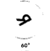

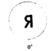
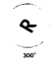
WHY?
Principle of the Shortest Path:
One image is upright, the other is rotated to 300 degrees.
Only a 60-degree rotation is actually needed for alignment.
This simplifies the decision process and speeds up the reaction time.
Comparison with Zero Degree Difference:
For example: both images are rotated by 60 degrees, lacking an upright reference.
This increases cognitive load and extends reaction time.
Upright Reference:
An upright image provides an intuitive reference, simplifying recognition in high-angle rotations.
Notes:
In this section, we'll discuss a notable finding from our mental rotation experiment: the significant decrease in reaction time at the 300-degree condition. This observation appears counterintuitive since larger angles typically increase cognitive load and reaction time.
However, our results suggest a simpler explanation involving the "shortest path" principle. When one image is upright and the other rotated to 300 degrees, participants effectively only rotate the image by 60 degrees, minimizing the cognitive effort required.
In contrast, a zero-degree difference, such as both images rotated by 30 degrees, lacks a direct reference, increasing the cognitive load and reaction time.
This highlights the importance of the relative rotation angle and the presence of an upright image as a reference, which simplifies the process especially at larger angles. These insights challenge us to reconsider how we present images in studies and suggest that mental rotation efficiency depends significantly on these factors.
These findings not only enhance our understanding of spatial processing in typical settings but also suggest new avenues for research into cognitive strategies and their applications.

Slide 18
Theoretical Significance and Practical Applications:
Theoretical Significance:
Unique Findings: Previous studies have not shown significant differences between mental rotations of faces and letters. Our study uniquely highlights this discrepancy, enhancing understanding in this area.
Broadened Scope: Traditionally focused on simple shapes, our research incorporates complex stimuli like faces and letters, extending spatial cognition studies. Faces involve intricate socio-emotional processing, explaining their prolonged rotation times.
Practical Applications:
Cognitive Rehabilitation:
a. Facial Recognition Training: Specifically designed for individuals with facial recognition impairments, our programs use gradually increasing rotation angles to enhance facial processing skills.
b. ADHD Treatment: Our approach helps improve focus and processing speeds in ADHD patients through progressively complex visual tasks.

Slide 19
Limitations:
Data Collection Constraints: Due to the setup of experimental facilities and time constraints, we were unable to collect neurophysiological data, such as EEG recordings. This represents a significant limitation of this study.
Sample Size: The relatively small sample size of this study may limit the generalizability of the results.
Experimental Design: The experimental setup may not adequately simulate the object recognition processes that occur in everyday life.
Notes:
Our limitations are focused on three main sections

Slide 20
Future Work:
Neurophysiological Data Collection: Utilize EEG and fNIRS devices to gather neurophysiological data, focusing specifically on the N170 components and Contralateral Delay Activity(CDA).
Diverse Participant Profiles: Expand the research to include participants from various educational backgrounds, genders, and cultural groups to enhance the diversity and applicability of the findings.
Emotional Faces in Research: Consider incorporating faces with different emotional expressions into the study. Investigate how different emotional states (such as happiness, sadness, or anxiety) and subtle social emotions (like contempt or embarrassment) influence mental rotation tasks of faces and other objects, and how these emotions modulate the neural mechanisms involved.
Integration of Virtual Reality: Introduce Virtual Reality (VR) technologies to create more realistic scenarios in mental rotation experiments. Additionally, incorporate physiological monitoring technologies such as eye-tracking and heart rate monitoring to collect real-time data on participants' physiological and cognitive responses during the tasks.
Notes:
Moving forward this is the last part, our research will embrace advanced neurophysiological tools to deepen our understanding of mental rotation. We plan to utilize EEG and fNIRS to specifically track the N170 and CDA components, which are crucial for assessing cognitive processes in real-time.
Additionally, we aim to diversify our participant base by including individuals from various educational, cultural, and gender backgrounds to broaden the use of our findings.
We will also explore the impact of emotions on mental rotation by incorporating faces with different emotional expressions. This will help us understand how emotions like happiness, sadness, or anxiety affect cognitive performance in these tasks.
Lastly, we're excited to integrate Virtual Reality technology to simulate more realistic environments. This, combined with physiological monitoring such as eye-tracking and heart rate monitoring, will provide comprehensive insights into the cognitive and physiological responses during mental rotation tasks.

Slide 21


Thanks for listening！

